Slide 1



Your quest to becoming a Beauchampion!
Your task details will be outlined in the following few slides

Slide 2

Task
Location, Location, Location!
Take a picture of yourself reading your favourite book in an exciting, interesting and unique location

Slide 3
Task
Things to consider
What is your favourite book?
You don’t need to necessarily go somewhere specific, can you be creative within your own home?
Be safe – don’t do anything dangerous

Slide 4
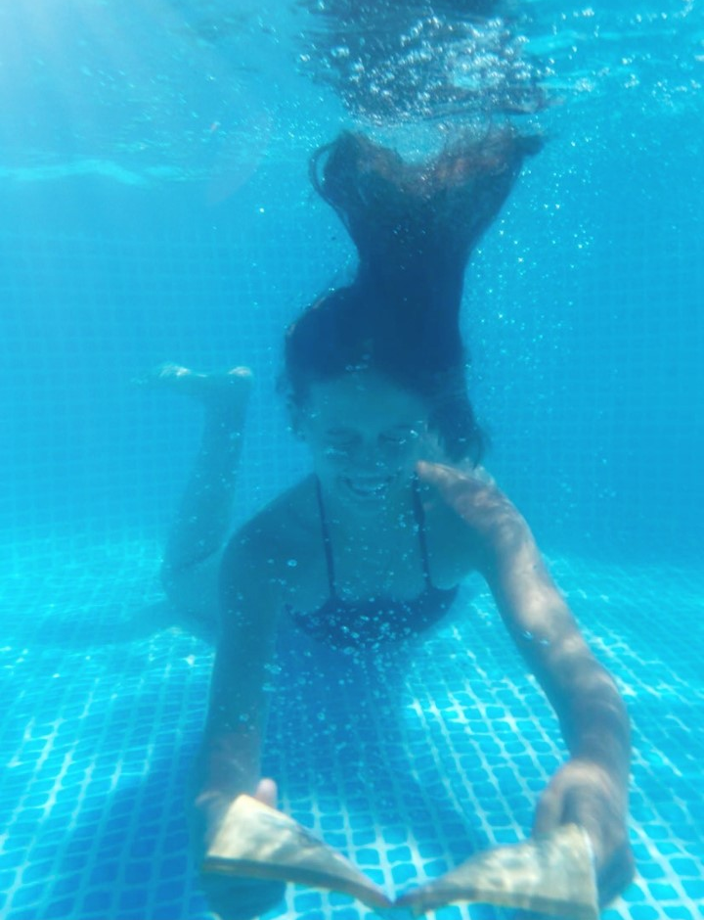
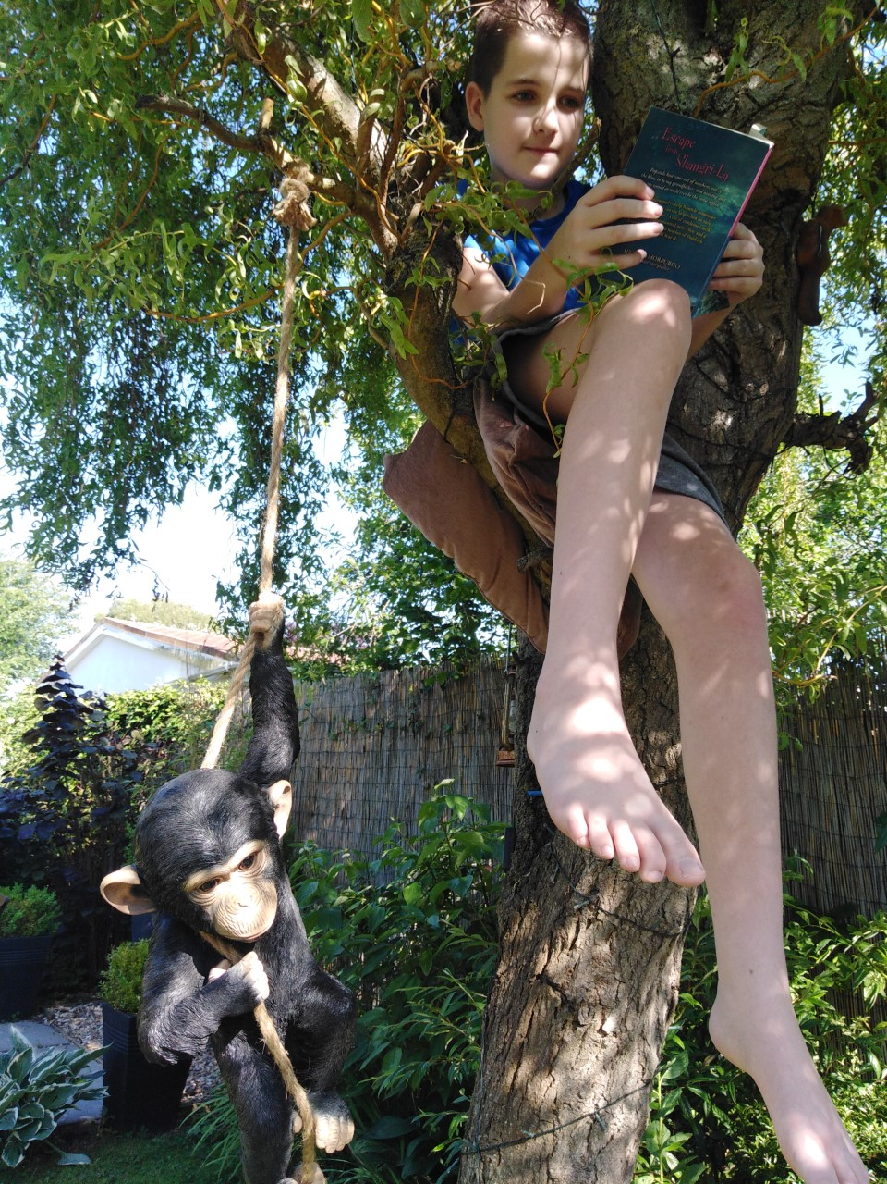
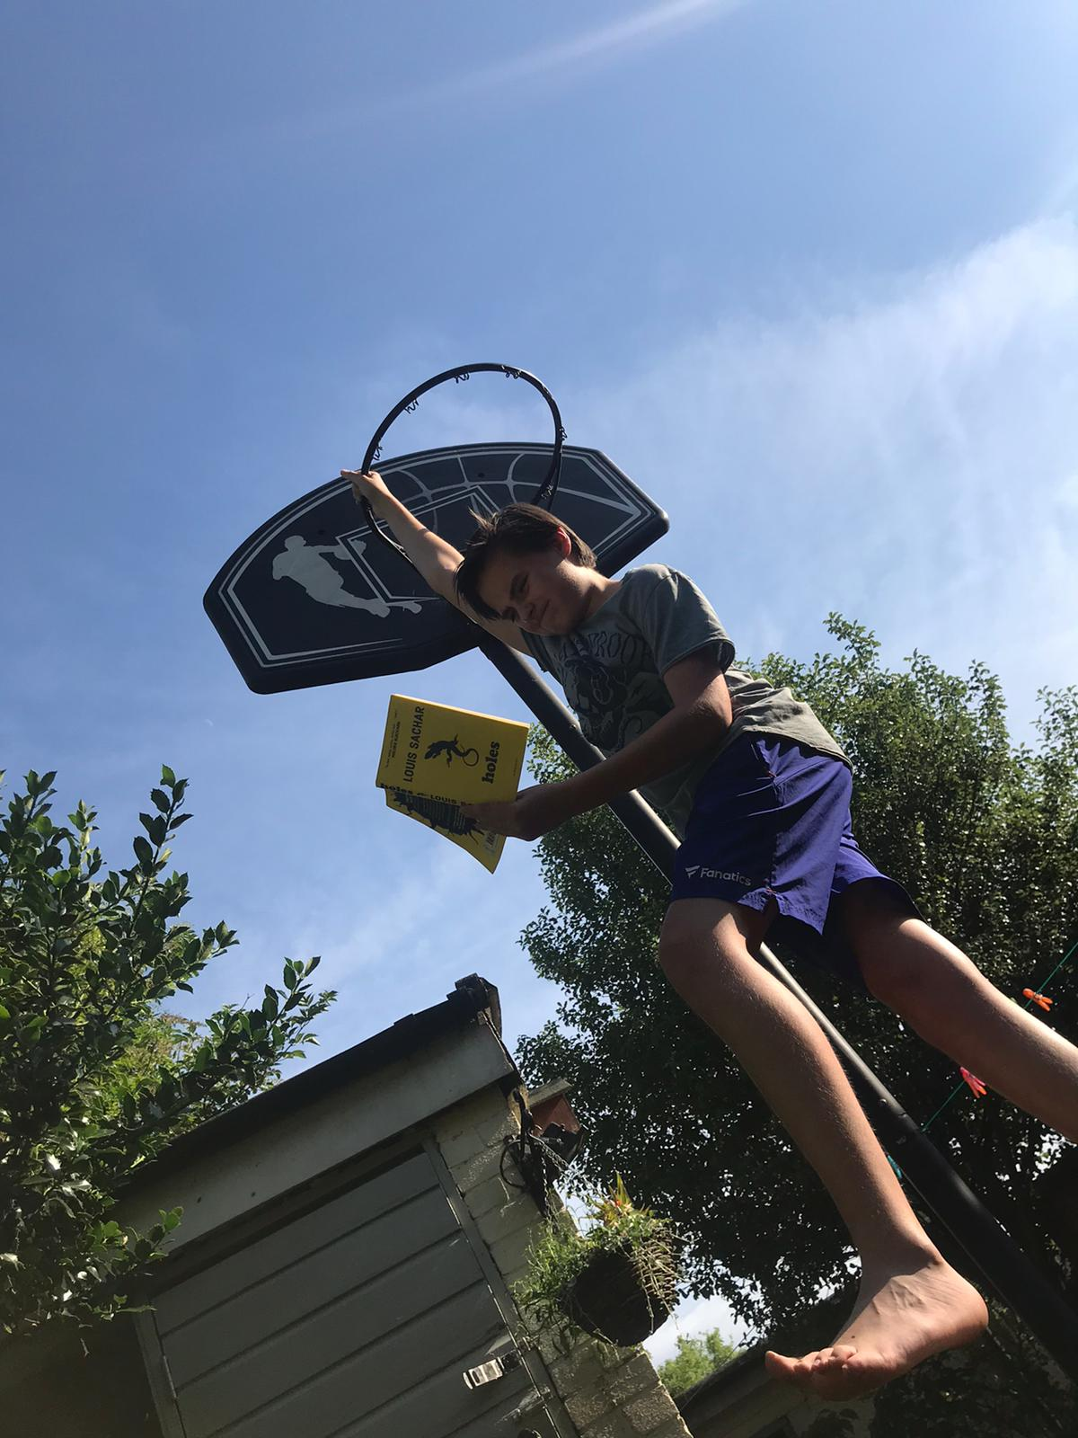
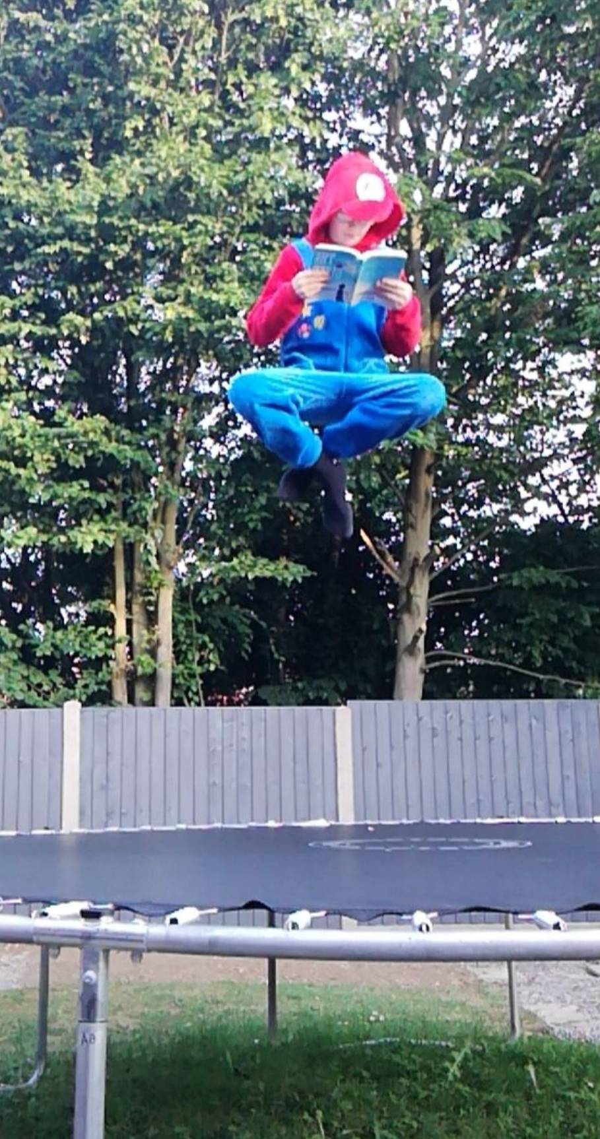
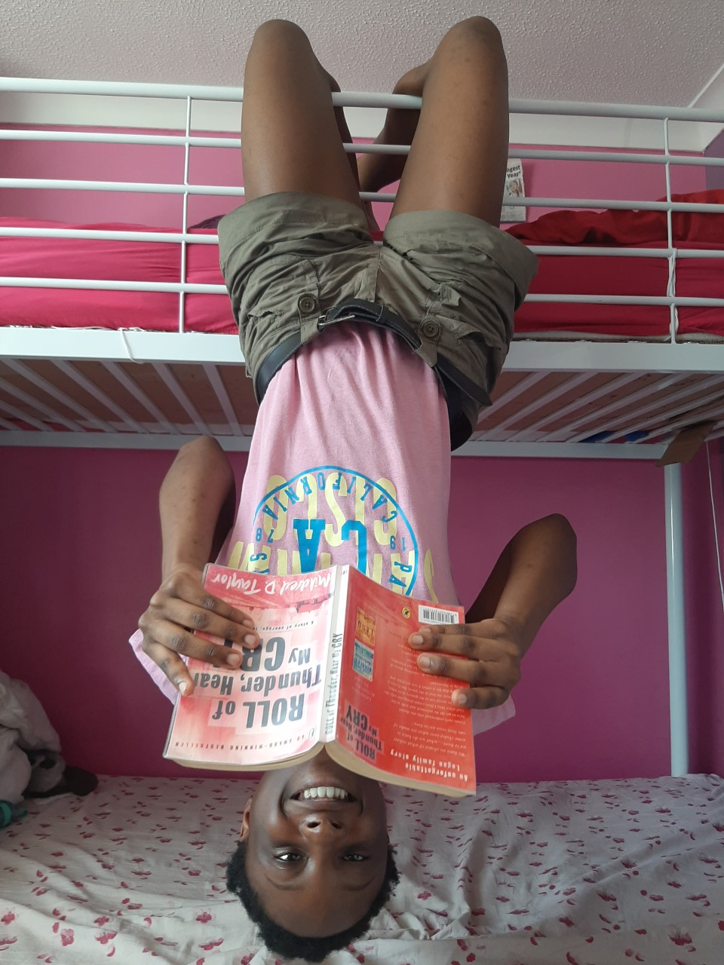
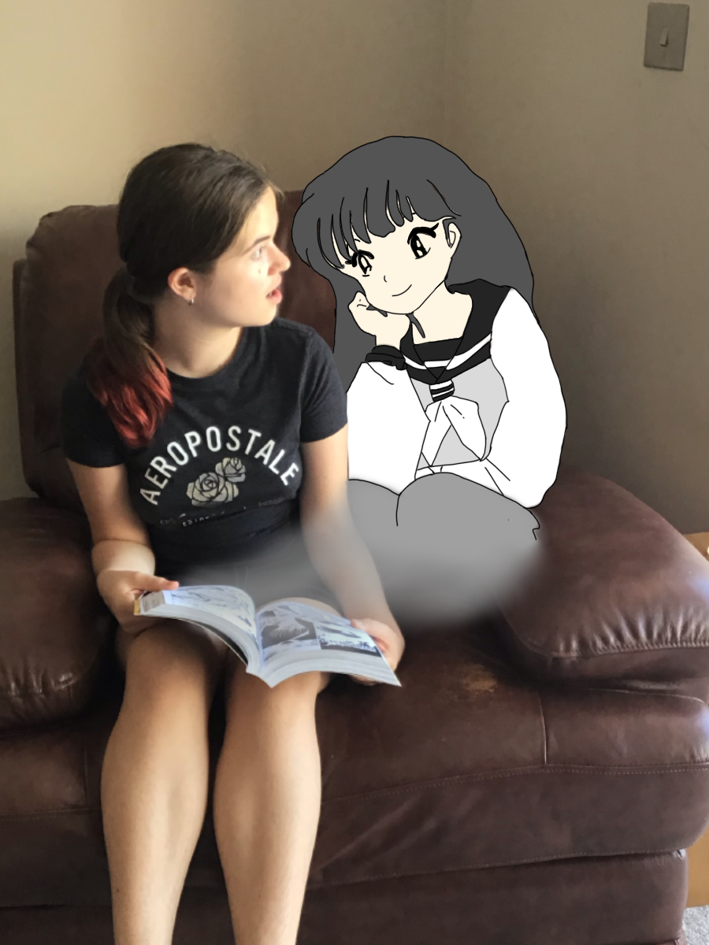
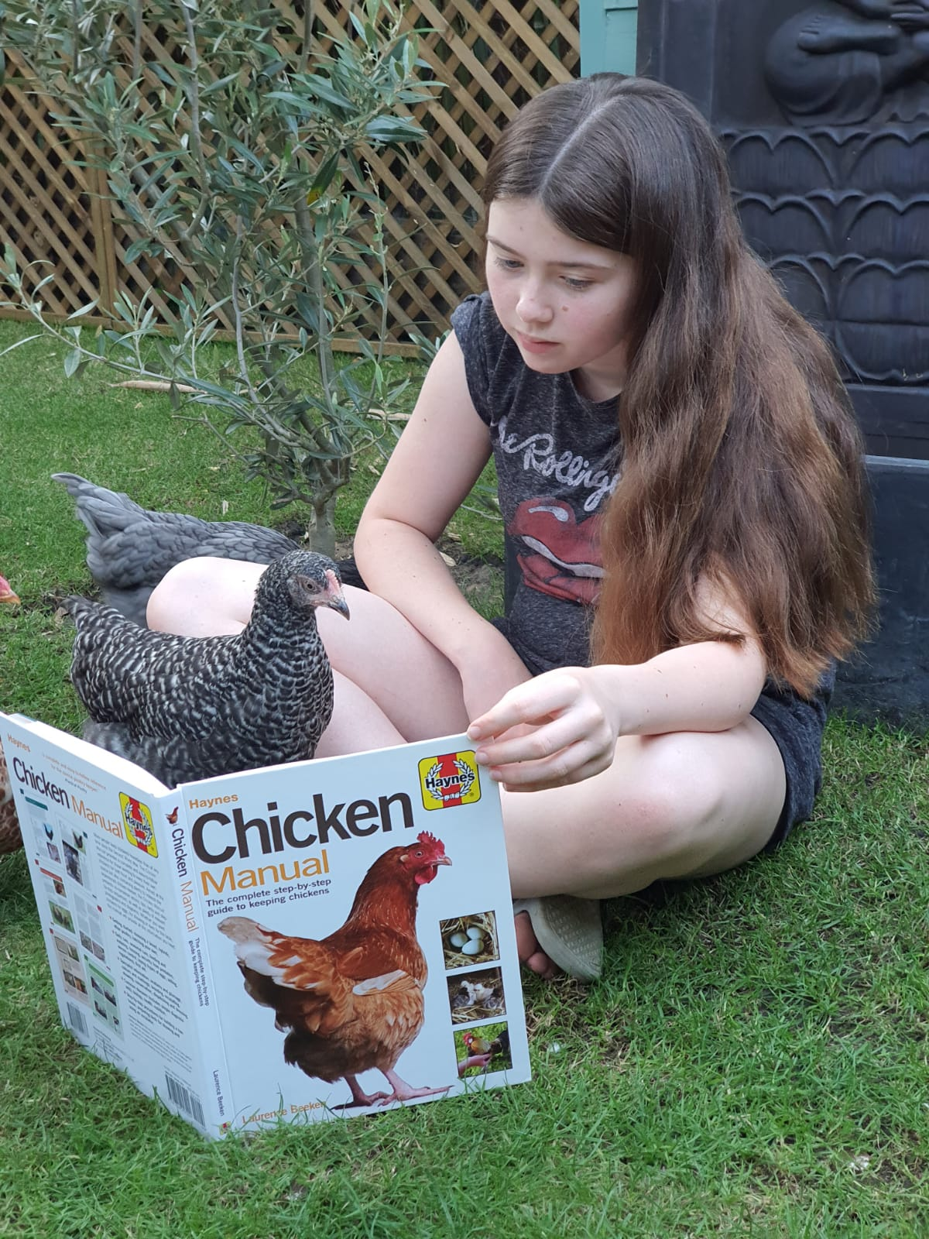
Examples

Slide 5
Want your merits?
Email your photos to:
dfitzsimmons@beauchamps.essex.sch.uk
There will also be a special prize for the most unusual reading locations
Look out for your photo when you start in September – it could be on display
Merits will be recorded and added to your Edulink account when you join us in September
Good luck!

