Slide 1


Welcome to Beauchamps
Year 7 Curriculum Guide

Slide 2
Our Curriculum
Here at Beauchamps High School we pride ourselves on providing an engaging and exciting curriculum. Our expert teachers work hard to promote a love of learning whilst teaching the necessary skills required for life beyond school.
Our schemes of work across all subject areas are carefully crafted to support our students through their academic journeys. Our KS3 provision prepares students well for GCSE study and beyond.
It is important for us to start this journey well. We have superb connections with our local feeder schools and work closely with them to ensure our curriculum builds and develops the skills taught at KS2. Our local feeder schools also engage in transition projects to help ease our students into life at secondary school.

Slide 3
Our Curriculum
History
Accelerated Reading
Art
Our creative and innovative Year 7 curriculum is constantly changing to reflect the needs and abilities of all our students.
We are fortunate enough to be able to offer a huge selection of engaging subjects across the week.
Social Studies
Geography
English
Ethics, Religion & Philosophy
French
Maths
Computing
Drama
Science
Music
Food and Nutrition
Competitive Sports

Slide 4






Core Subjects
English: Students will be exposed to a wide range of texts throughout the year including poetry, Shakespeare, dystopian literature and 19th century fantasy fiction. We celebrate key events including Black History Month, National Poetry Day and World Book Week. Students will also get the opportunity to be involved in a Poetry in Performance Interschool Recital Competition. There are also a number of after school reading groups to get involved in.

Slide 5
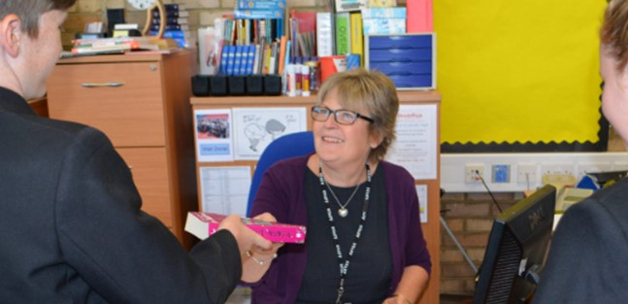
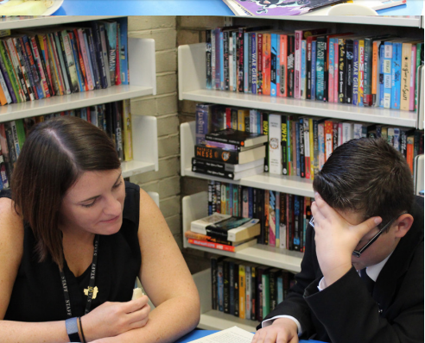
Core Subjects
Accelerated Reading: Students have a weekly session in the Learning Resources Centre (Library), where they follow the Accelerated Reader programme, giving them time to practise and develop their reading for pleasure, inspired by the wide range of material available.

Slide 6

Core Subjects
Maths: Students will be focussing on the five main areas of mathematics, with time spent ensuring that gaps in knowledge are addressed early on The topics taught are aimed to be used across all subjects and allows us to best prepare pupils for life after school.

Slide 7
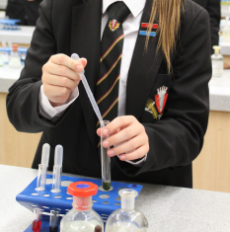
Core Subjects
Science: After an initial unit covering health and safety in the Science Labs, students will cover the key scientific concepts of cells, particles, energy and forces, using practical and investigatory skills.

Slide 8

Humanities
Geography: Students will build upon map skills then take a thematic route across both physical and human geography, looking at coasts and settlement. We finish the year with fieldwork, where students get a chance to get out of the classroom and put what they have learnt into action.

Slide 9
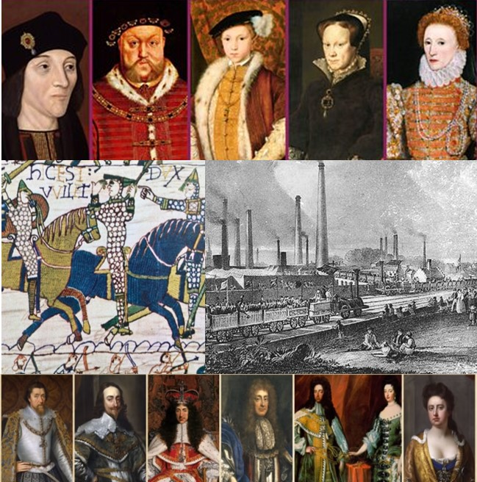
Humanities
History: Students will develop research and analytical skills by going on a historical journey through Britain, from the Medieval period, through the Tudor monarchy and ending in the midst of the Industrial Revolution. They will look into different aspects of life in Britain and explore how life has changed.

Slide 10


Humanities
ERP: Students develop and deepen their knowledge of the world religions, studying a wide variety of topics to enable them to make academic comparisons between religious and non-religious beliefs. They will develop their respect and tolerance of all cultures and beliefs in our multicultural society.

Slide 11

Humanities
Social Studies: Topics such as discrimination, relationships and democracy will be delivered through a variety of cross-curricular opportunities, making topics relevant for students by linking them to what they are studying in other subjects . Themes include internet safety, healthy eating and equality. Year 7 will also have a programme of RSE lessons covering topics such as consent and equality, in line with the DfE statutory guidance and the school's PSHE policy, which can be found on the website.

Slide 12


Languages
French: Students will develop their communication skills in French through speaking, listening, reading and writing. They will be able to take part in basic conversations and role plays and gain confidence in speaking the French language.

Slide 13
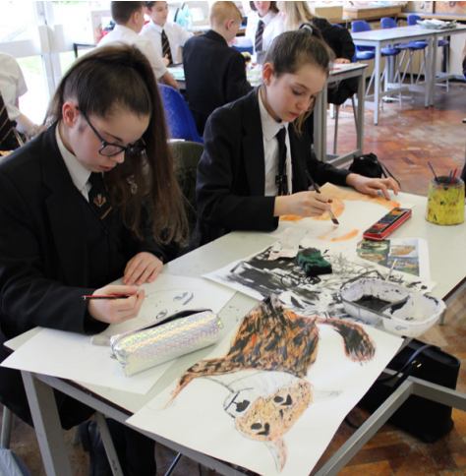
Art, Design and Technology
Art: Students start with basic drawing skills, realising the uses of tone and shape. They will research an artist, using their work to explore watercolour and still life, then analyse paintings in depth using colour theory. Students then begin an illustration project, learning how illustration and Fine Art differ.

Slide 14
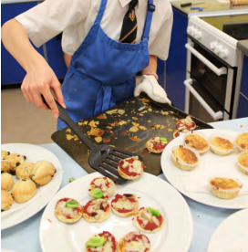
Art, Design and Technology
Food and Nutrition: Students will have a mix of theory and practical sessions. They learn the importance of healthy eating, establish the source and supply of food and understand how to keep themselves and food safe in the kitchen. They will learn to use a variety of cooking methods and techniques.

Slide 15
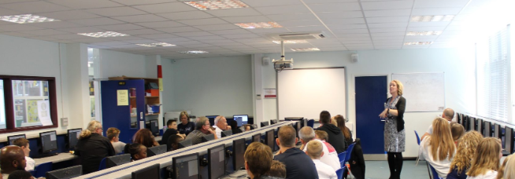
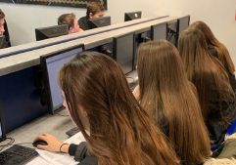
Art, Design and Technology
Computing: Students will learn the importance of E-Safety and looking after themselves online. Digital literacy will be increased by recognising the importance of increasing skills with different types of software and good file management. Higher level programming is introduced with a bit of retro gaming!

Slide 16
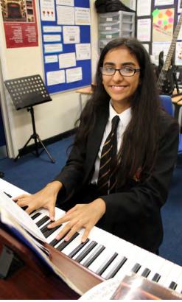
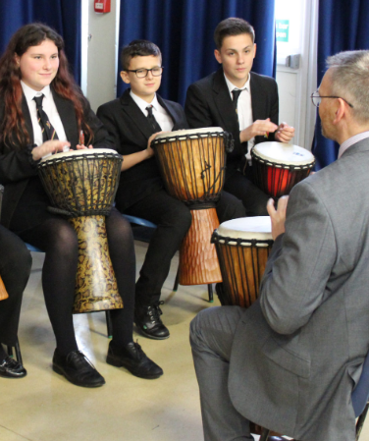
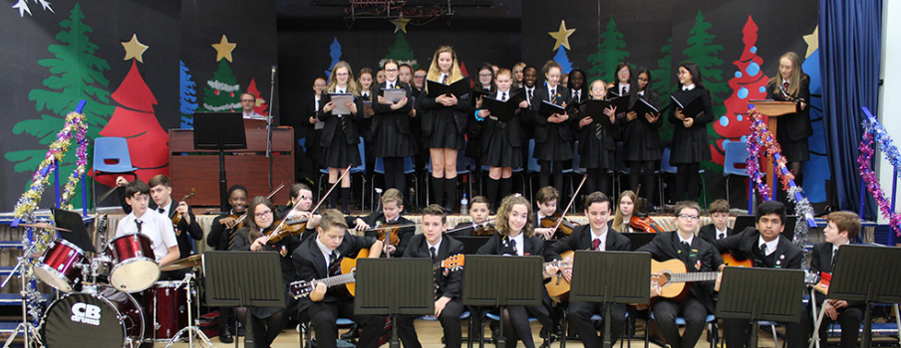
Arts and Sports
Music: Students will develop skills in composing, performing, listening and appraising, and have the opportunity to learn different instruments including the ukulele, guitar and keyboard. They will learn how to read musical notation and recognise and understand the elements of music in many different genres.

Slide 17


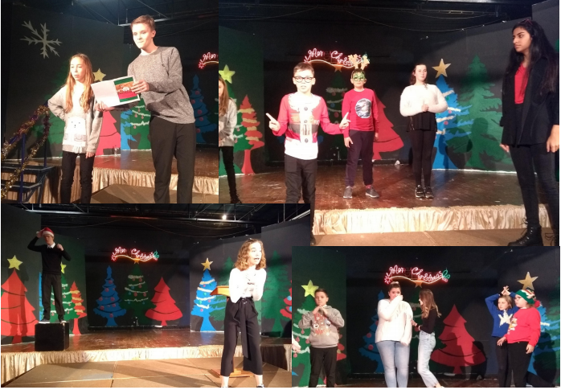
Arts and Sports
Drama: Students will be introduced to the key skills for performance work, exploring a wide range of topics and themes. They will have the opportunity to perform, direct and create, accessing a curriculum that focuses on wellbeing, building confidence, resilience, being a team player and being creative.

Slide 18
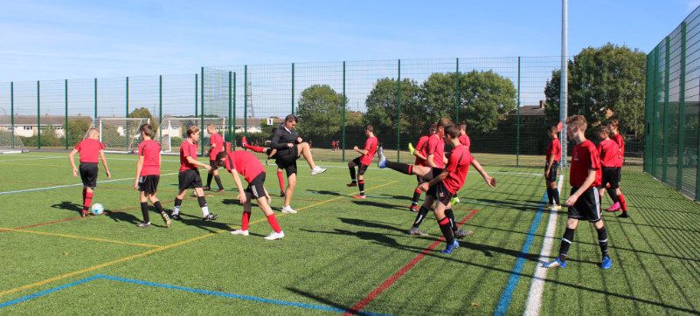
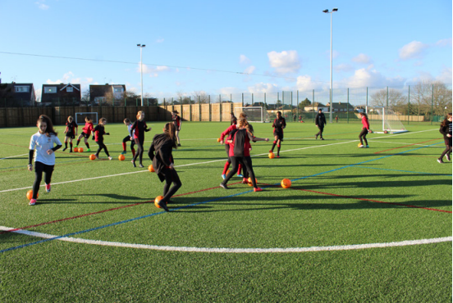
Arts and Sports
Competitive Sports: Students have two lessons per week in a variety of sports including: football, rugby, basketball, netball, badminton, trampolining, table tennis, fitness, cross-country, athletics, rounders, cricket, softball, dance and outdoor adventurous activities. They learn how to make informed choices about healthy and active lifestyles.

