Slide 1



Your quest to becoming a Beauchampion!
Your task details will be outlined in the following few slides

Slide 2

Task
Write a poem about your feelings towards starting Beauchamps

Slide 3
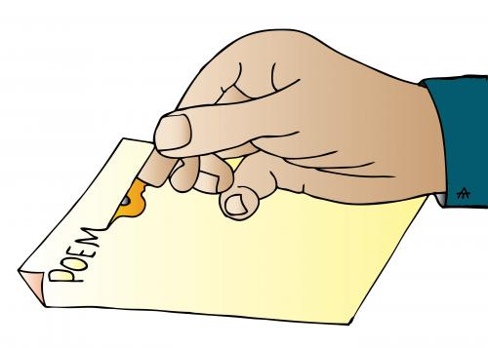
Task
Things to consider
Do you want your poem to rhyme? – It doesn’t have to
What techniques will you include? – Do you want to include adjectives, similes, alliteration etc?
How do you want to set it out? – In stanzas, do you want it to be an acrostic poem?

Slide 4
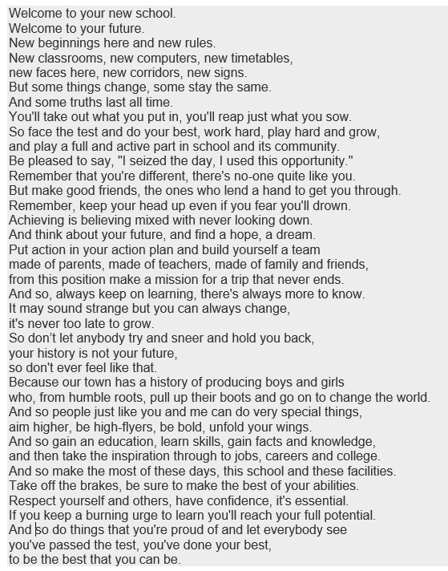
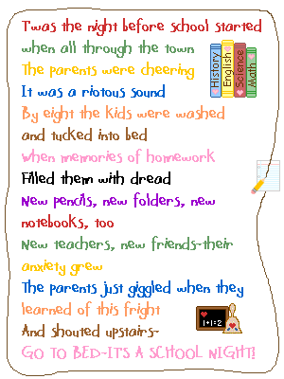

Examples

Slide 5
Want your merits?
Email your completed poems to:
dfitzsimmons@beauchamps.essex.sch.uk
Look out for your poem when you start in September – it could be on display
Merits will be recorded and added to your Edulink account when you join us in September
Good luck!

